Slide 1
Mission
The reference AD WG is responsible to drive AWF toward a reference Electric and Electronic Architecture for autonomous mobility platforms.
The new WG can come up with a reference platform which is best suited to run Autoware Core or extended to run Autoware Universe.

Slide 2
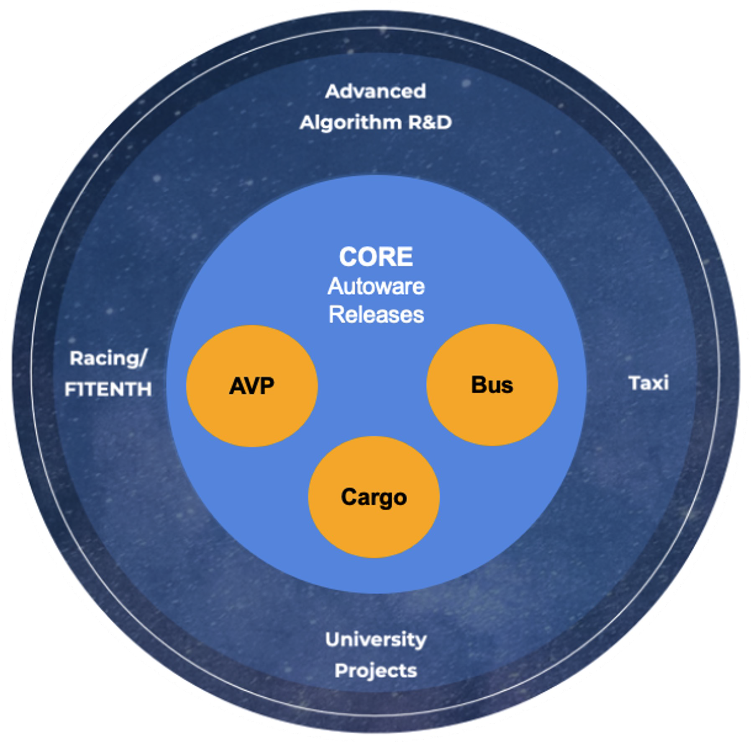





Autoware Core/Universe
CORE
Complete end-to-end autonomous driving framework
Supports all current AWF ODDs
Provides the definitions and functionality for which other packages can extend
Strict code and quality control
Heavily managed by the AWF
Stable base implementation
UNIVERSE
Additional packages built on top of Core
Extends Autoware functionality beyond the AWF ODDs
Completely dependent on Core functionality and message deflnitions
Relaxed code and quality control
Community managed
Enables quick experimentation and prototype testing

Slide 3
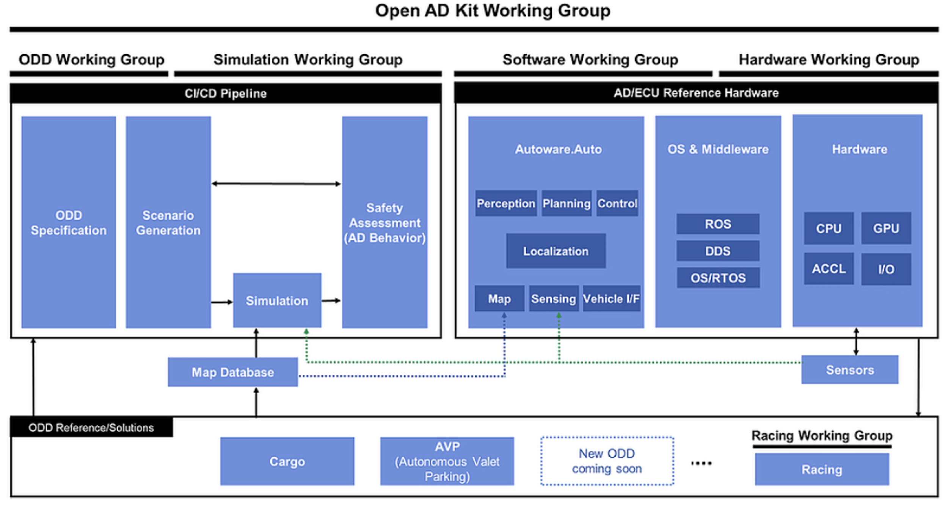




AWF Work Groups (Out-of-date)
Mapping Working Group
Autonomous Valet Parking
Cargo
Bus
Taxi

Slide 4
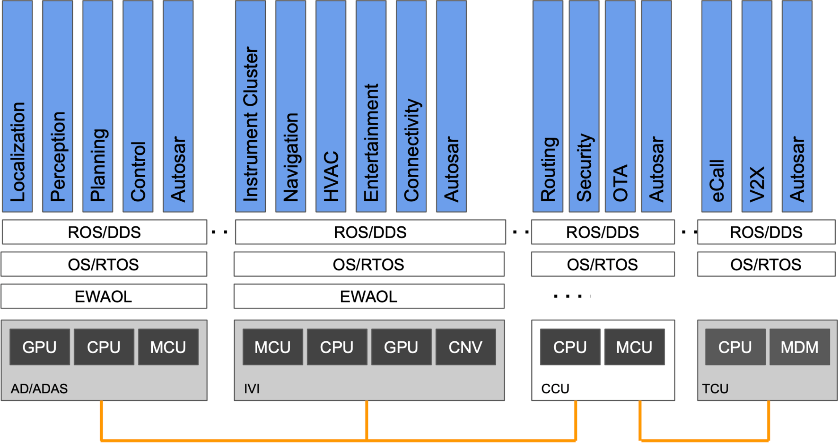
SDV Related WG Scope Overview
WGs to align areas of collaboration
API WG: APIs to other Applications (e.g. IVI, V2X)
OADKit API
Reference Implementations
Safety/Certification
etc.
Ref Des
Open AD Kit WG: Autoware implemented in a microservices architecture on SOAFEE (EWAOL)
Ref Des WG: HW Architecture, OS/RTOS, and Middleware to address requirements for Auto and Safety
Steering, Accel, Brake
DBW

Slide 5
Goals
The AD WG can get off the ground quicker by setting minimal requirements for the computation platforms.
Short-Term Goals (within the first year)
• With the help of participants who had good experience with automotive hardware, arrive at an E/E Architecture that can support Autoware Core on an existing target demo vehicle.
Long-Term Goals (in a time span of two years)
• Examine the approaches of domain controller architecture and zonal architecture, and propose how or if Autoware should be configured to handle both architecture trends.

Slide 6
Status
Report on TSC meeting on April 19, 2023 to kick off the WG.
Meeting minutes: (doc)
Wiki Page (doc)
The WG will be co-chaired by Daniel SHIH (Tier4/NTU) and Stephen Li (Autocore).

Slide 7
Meeting Format
To achieve Short-Term Goals (within the first year) and Long-Term Goals
• With the help of participants who had good experience with automotive hardware, arrive at an E/E Architecture that can support Autoware Core on an existing target demo vehicle.
Format:
Select targeted existing demo scenario (TBD), given the defined ODD.
Valet Parking, Cargo, Racing, Bus, and Taxi.
Invite volunteers to share the experiences on using different platforms on selected ODD.
Find the commodity among different platforms and report the reference E/E in Q3/Q4 2023.

Slide 8

What is Autoware?
Before the advent of Autoware, components of autonomous vehicles were developed as proprietary assets and the progress of autonomous driving technology was impeded, but now everything has changed.
The first all-in-one open source software for autonomous driving
Originally created in 2015 by Shinpei Kato at Nagoya University
Based on the open-source ROS middleware
Autoware is:
Complete AD software stack
Independent of vehicle type or electronic hardware
Governed by an independent foundation
Completely open-source (licensed under Apache License 2.0)
Autoware

Slide 9




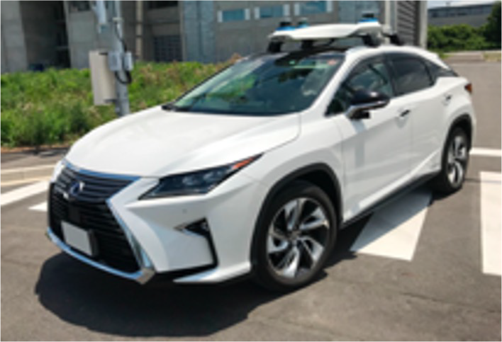






Autoware Ecosystem
Infrastructure
Insurance
Communication LTE / 5G
MAP
Government
Technology
Road Regulation
Sensor / Silicon
Inspection Scheme
Super City Planning
ECU
manufacture
By-wire / EV OEM
Apps on Autoware
MaaS Service
Service Provider
Cloud Service

Slide 10
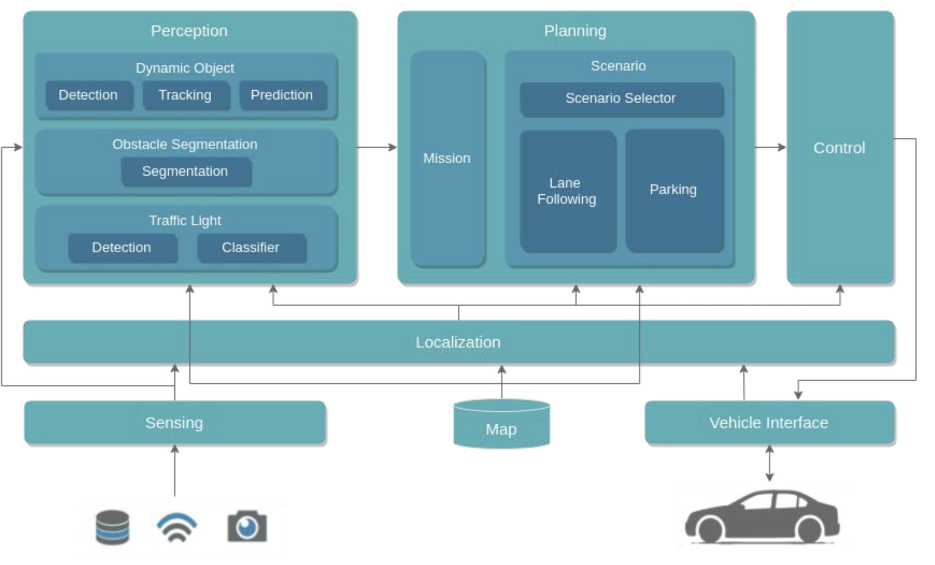
Autoware Software Architecture
Autoware consists of all the functionality required for autonomous driving (i.e. perception, planning, control) in a modular architecture with well defined interfaces and APIs.
https://github.com/autowarefoundation/autoware https://autowarefoundation.github.io/autoware-documentation/main/

